Slide 1
Implementasi Fine-Tuning BERT untuk Indo News Classification
BERT PAPER : https://arxiv.org/pdf/1810.04805.pdf

Slide 2
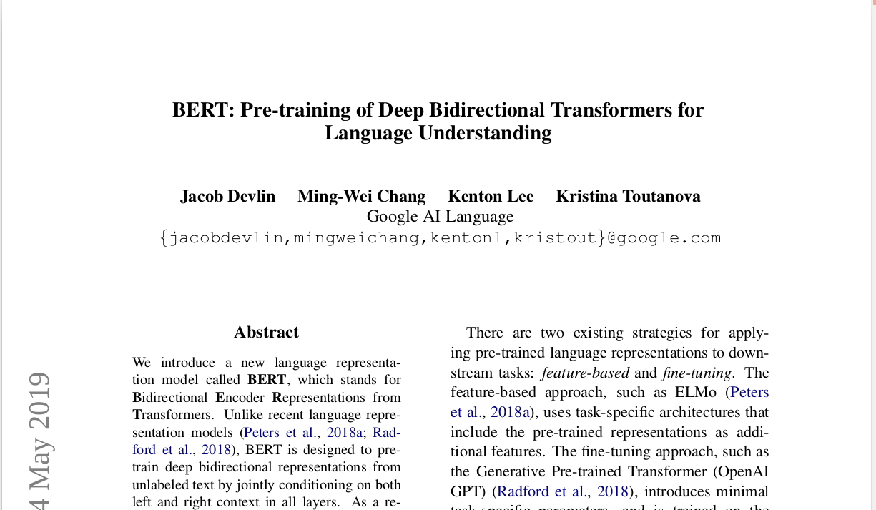

Slide 3

A little history
RNN is invented by Hopfield (1982)
LSTM is invented by Hochreiter & Schmidhuber (1997)
Transformer is invented by Vaswani (2017) (https://arxiv.org/pdf/1706.03762.pdf) - “Attention Is All You Need” for machine translation task (seq2seq architecture)
Resources :
LSTM is dead. Long Live Transformers!
Transformer Neural Networks - EXPLAINED! (Attention is all you need)
The Illustrated Transformer – Jay Alammar – Visualizing machine learning one concept at a time.

Slide 4
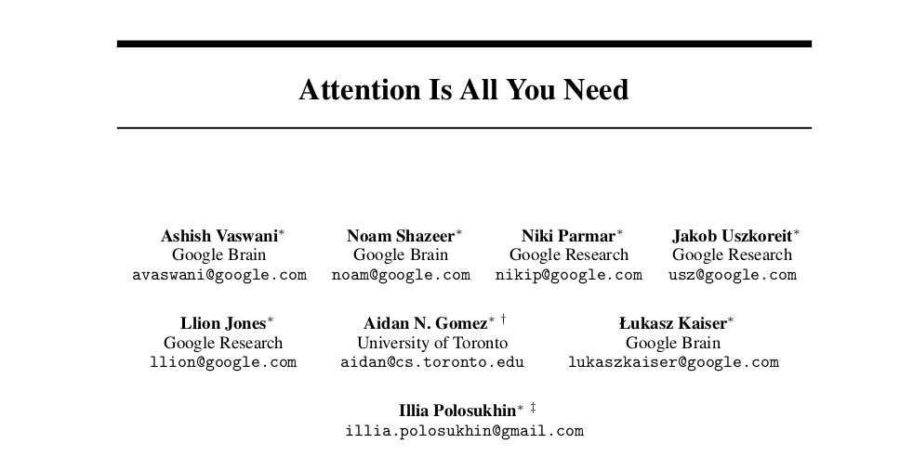

Slide 5
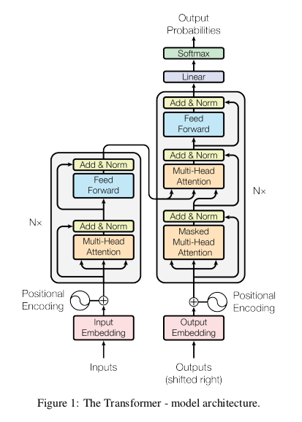
Encoder
Decoder
Transformer
Encoder-Decoder Attention (input-output)
Sub-layer
Sub-layer
Sub-layer
Encoder Self-Attention (input-input)
Masked Decoder Self-Attention (output-output)
Sub-layer
Sub-layer
saya akan beristirahat di rumah
I will rest at home

Slide 6
Transformer Component
Input Embedding (word embedding)
Positional Encoding
Encoder Block - Multi Head Attention
Encoder Block - Position-wise FFN
Encoder Block - Add & Norm
Decoder Block
Linear Transformations, Softmax
Kita tahu kalau RNN punya kemampuan untuk meng-capture informasi pada sequence data, karena hidden state bisa menggabungkan representasi kata/vektor sebelumnya dengan representasi kata saat ini.
Agar transformer dapat melakukan hal yang kurang lebih sama maka muncullah positional encoding dan attention

Slide 7
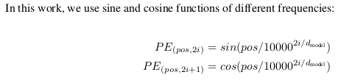
2. Positional Encoding
“Vektor yang memberikan konteks berdasarkan posisi suatu kata pada kalimat”
keterangan : pos = posisi kata dalam sebuah kalimat i = dimensi d_model = dimensi model (default transformer = 512) = input embedding

Slide 8
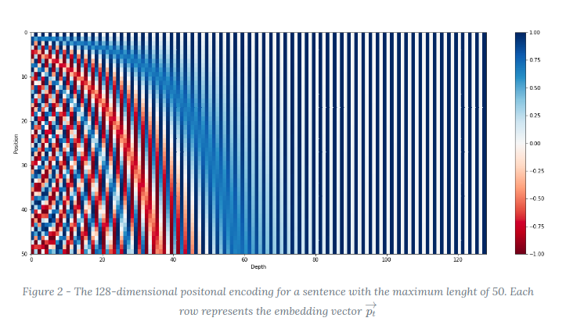
2. Positional Encoding

Slide 9
3. Attention
Attention = perhatian atau “Fokus pada sesuatu”
Misalnya kita punya sebuah input kalimat seperti ini :
”The animal didn't cross the street because it was too tired”
Apa yang dimaksud "it" dalam kalimat ini? Apakah ini menunjukkan “street” atau “animal” ? Ini pertanyaan sederhana bagi manusia, tetapi tidak sederhana untuk komputer.
Ketika model memproses setiap kata (setiap posisi dalam urutan input), self attention memungkinkannya untuk melihat posisi lain dalam urutan input untuk memberikan informasi yang dapat membantu mendapatkan “better encoding” suatu kata.

Slide 10
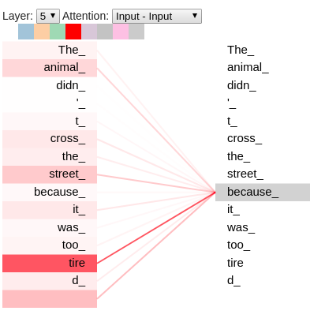
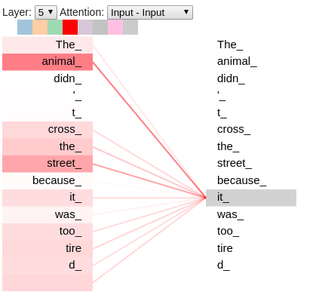
3. Attention (tensor2tensor by tensorflow)

Slide 11
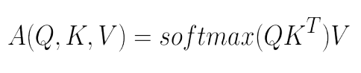
3. Attention
Attention is all you need; Attentional Neural Network Models | Łukasz Kaiser | Masterclass (Author - Google Brain)
Dot-Product Attention
Apa itu Q, K, V ? The general idea is ….
Q (query) = vektor yang merepresentasikan kata
K (key) dan V(value) = memory, semua kata yang telah di-generate sebelumnya Note : K dan V bisa bernilai sama

Slide 12
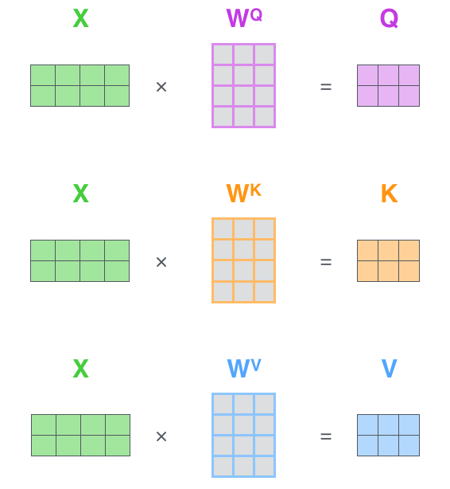
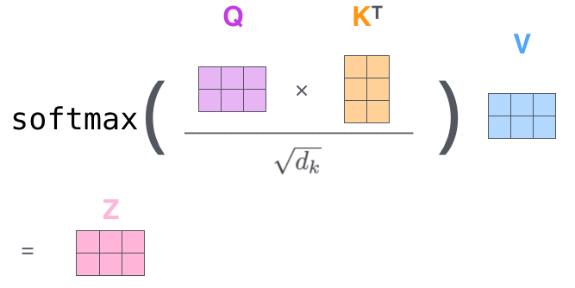
3. Attention

Slide 13
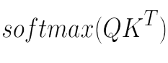
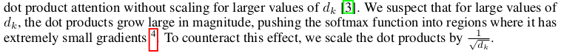
3. Attention
Apa yang dilakukan Attention ? Note : d_k = dimension of key (input sequence length) “Take the query (Q)(word in most cases), then find the most similar key (K), and then get the values (V) that correspond to these similar key (K)”
Hasil dari akan memberikan“probability distribution over keys
which is peaked at the one that are similar to the query”

Slide 14
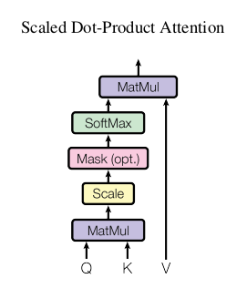
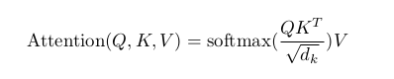
3. Attention

Slide 15
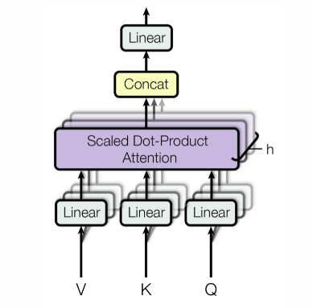
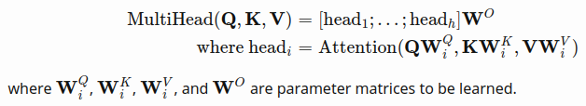
3. Multi-Head Attention
Menurut paper : “multi-head attention allows the model to jointly attend to information from different representation subspaces at different positions. With a single attention head, averaging inhibits this.”

Slide 16
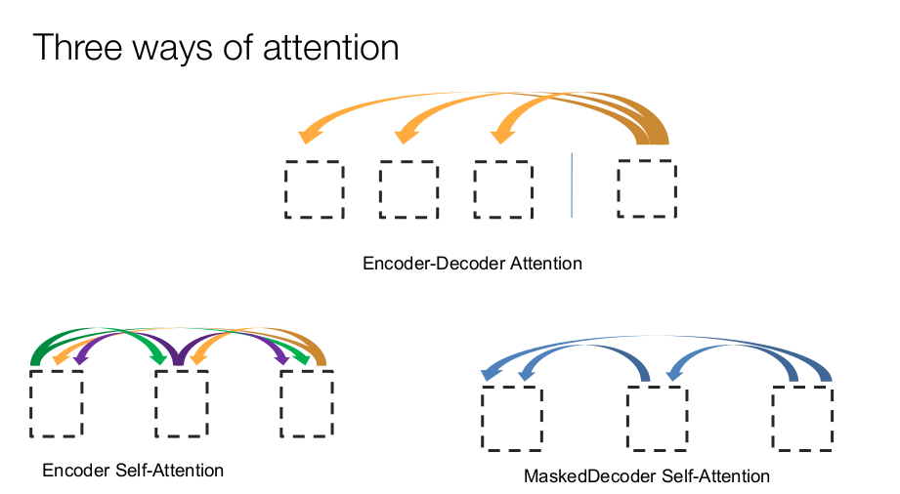
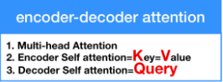
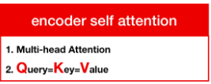
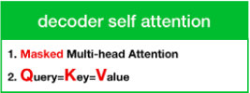
SAYA
AKAN
BERISTIRAHAT
AT
SAYA
AKAN
BERISTIRAHAT
I
WILL
REST
Notes:
Masking multi-head attention is done by masking future positions (setting them to -∞) before the softmax step in the self-attention calculation. This step ensures that the predictions for position i can depend only on the known outputs at positions less than i

Slide 17
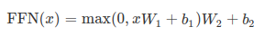
4. Position- wise Feed Forward Network (FFN)
Linear transformation (1) -> ReLu activation -> Linear transformation (2)

Slide 18
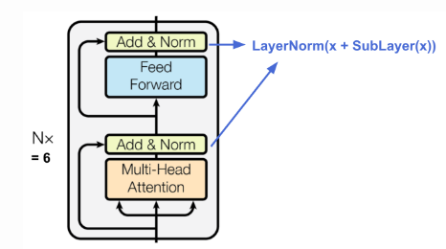
Encoder
N = 6 stack encoder
dimensi model = 512

Slide 19
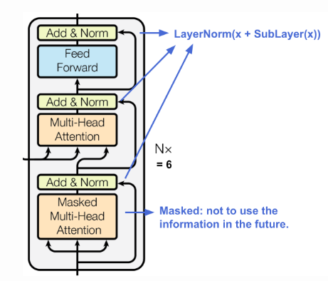
Decoder
N = 6 stack encoder
dimensi model = 512
Masked Multi-Head Attention -> hide the future decoder inputs (the next words of a translated sentence)
Notes:
The reason that masked multi-head attention block is so called is that way it is necessary to hide the future decoder inputs (the next words of a translated sentence). If the decoder sequence is not shifted, the model learns to simply copy the decoder input. One reason is that the model should not learn to copy the decoder inputs during learning, it is that it must learn with a sequence of the encoder and a sequence of the decoder (previous words) already seen by the model, the following word will be predicted.

Slide 20
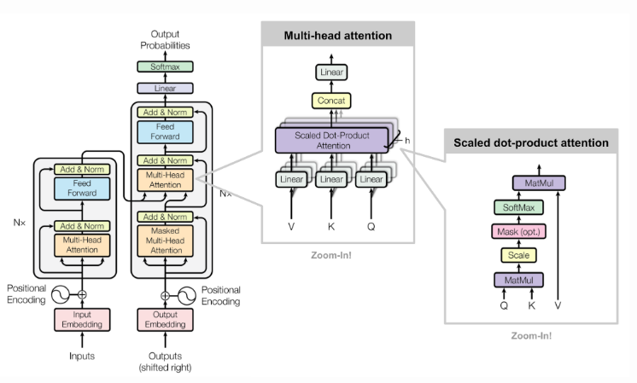
Full Architecture of Transformer
Optimizer : Adam
Regularization :
Residual Dropout (apply dropout for the output of each sub-layer) = 0.1
Label Smoothing = 0.1

Slide 21
Let’s start BERT
Bidirectional Encoder Representations from Transformers (BERT)
BERT is a method of pre-training language representations, meaning that we train a general-purpose "language understanding" model on a large text corpus (like Wikipedia), and then use that model for downstream NLP tasks that we care about (like question answering).
Ada 2 tahapan pada framework BERT :
Pre-training (train on unlabeled data for different task)
Fine-tuning (transfer learning, train classification layer)
Pre-training data menggunakan BookCorpus (800M words) dan English Wikipedia (2500M words)

Slide 22
Let’s start BERT
BERT is . . .
Unsupervised -> BERT dilatih hanya menggunakan plain text corpus
Contextual representations -> satu kata bisa memiliki multiple “word embedding” representasi yang bergantung pada kalimat (ex: tahu)
Bidirectional -> representasi kata berdasarkan left dan right context
Can learn relationships between sentences
Notes:
context-free -> word2vec, GloVe -> generate a single "word embedding" representation for each word in the vocabulary

Slide 23
Advantages of Fine Tuning
Quicker Development (only need 2-4 epoch for fine-tuning BERT on specific dataset)
Small dataset / less data
Better results

Slide 24
BERT Architecture
BERT base (L=12, H=768, A=12, vocab around 30k token , Total params = 110M, english text)
BERT large (L=24, H=768, A=16, vocab around 30k token, Total params = 340M, english text)
BERT base-multilingual (L=12, H=768, A=12, vocab around 110k token , Total params = 110M, 104 languages text)
Original Transformer (L=6, H=512, A=8)
L : jumlah transformer blok
H : hidden size
A : jumlah attention head

Slide 25
Special Tokens
[CLS] : token pertama untuk setiap sequence, dan token untuk classification task
[SEP] : token delimiter atau pemisah antar sequence yang digunakan untuk pre-training pada sequence-pair tasks
[MASK] : token yang digunakan untuk “mask” sebuah kata, token ini hanya digunakan ketika pre-training

Slide 26
Pre-training BERT
Task #1 : Masked LM (MLM) -> give bidirectional ability
Task #2 : Next Sentence Prediction (NSP) -> give ability to learn relationships between sentences

Slide 27
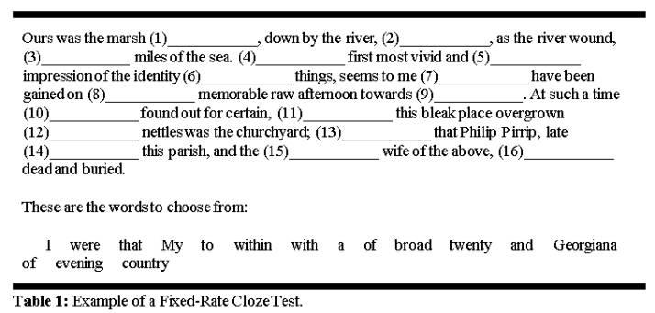
Task #1 : Masked LM
Cara ini terinspirasi dari Cloze Test

Slide 28
Task #1 : Masked LM
Contoh kita punya sebuah kalimat : “my dog is hairy”, lalu saat prosedur random masking kita pilih token ke-4
80% : Ganti kata dengan [MASK] token (my dog is hairy -> my dog is [MASK])
10% : Ganti kata dengan kata random (my dog is hairy -> my dog is apple)
10% : Pertahankan kata (tidak berubah) (my dog is hairy -> my dog is hairy)
Berdasarkan paper : “The advantage of this procedure is that the Transformer encoder does not know which words it will be asked to predict or which have been replaced by random words, so it is forced to keep a distributional contextual representation of every input token.”

Slide 29
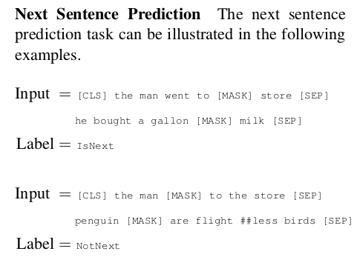
Task #2 : Next Sentence Prediction (NSP)

Slide 30
Task #2 : Next Sentence Prediction (NSP)
Berguna untuk case Question-Answering, Natural Language Inference, etc
Berapa persentase sebuah kalimat merupakan “actually next sentence” ?
50% dari kalimat dipasangkan dengan kalimat yang berdekatan / berhubungan
sedangkan 50% nya dipasangkan dengan random kalimat dari korpus

Slide 31
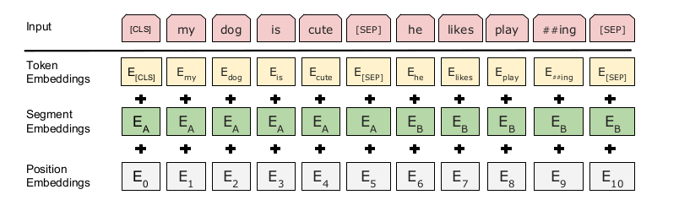
Input Embeddings
Pertama - tama, input text di tokenize menggunakan metode WordPiece (sub-word)
Notes:
WordPiece balance between size of vocab and handle out-of-vocabulary (oov)

Slide 32
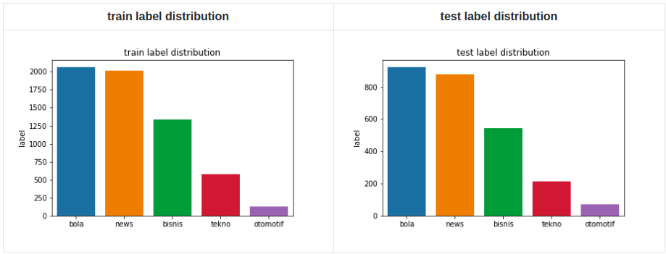
Fine-tuning BERT for sentence classification
Indonesian News Dataset by Andreas Chandra : https://github.com/andreaschandra/indonesian-news

Slide 33
Fine-tuning BERT for sentence classification
https://colab.research.google.com/drive/1LIjYzckI9z55PA4AVklKOaxjPp0Q5YJ0?authuser=1

Slide 34
Resources :
BERT Research Series
Kaggle Coffee Chat: Jacob Devlin (Google Researcher, BERT author) | Kaggle
🏎 Smaller, faster, cheaper, lighter: Introducing DilBERT, a distilled version of BERT
~ THANK YOU ~
rubentea16.github.io

